Slide 1

The global situation of viral load testing for treatment monitoring
Amsterdam
July 2018

Slide 2
Disclaimer: I have no conflicts of interest

Slide 3
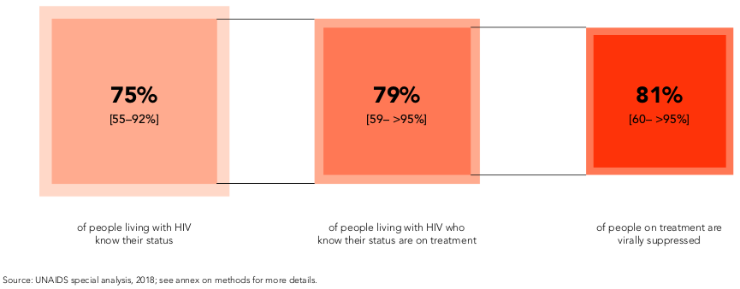
90-90-90 Progress

Slide 4
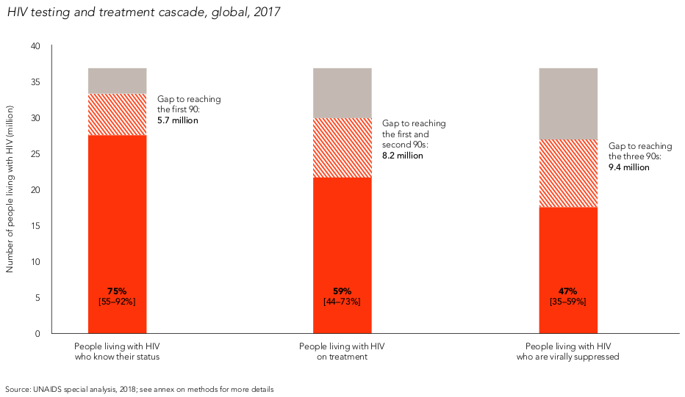

Slide 5
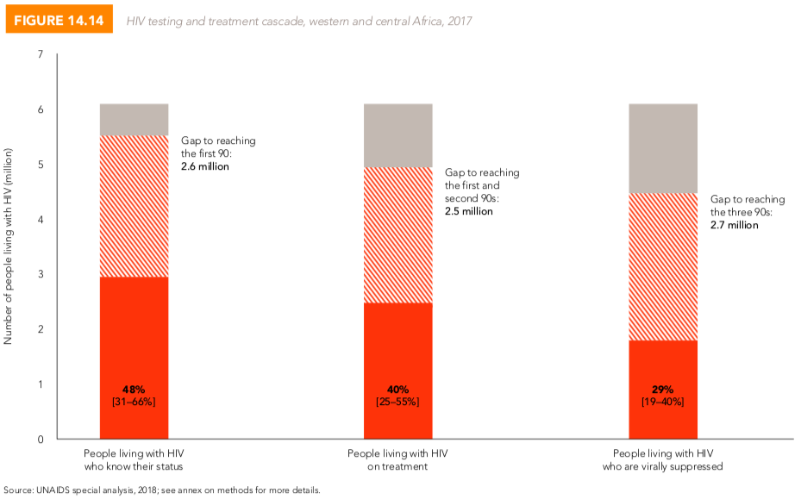

Slide 6
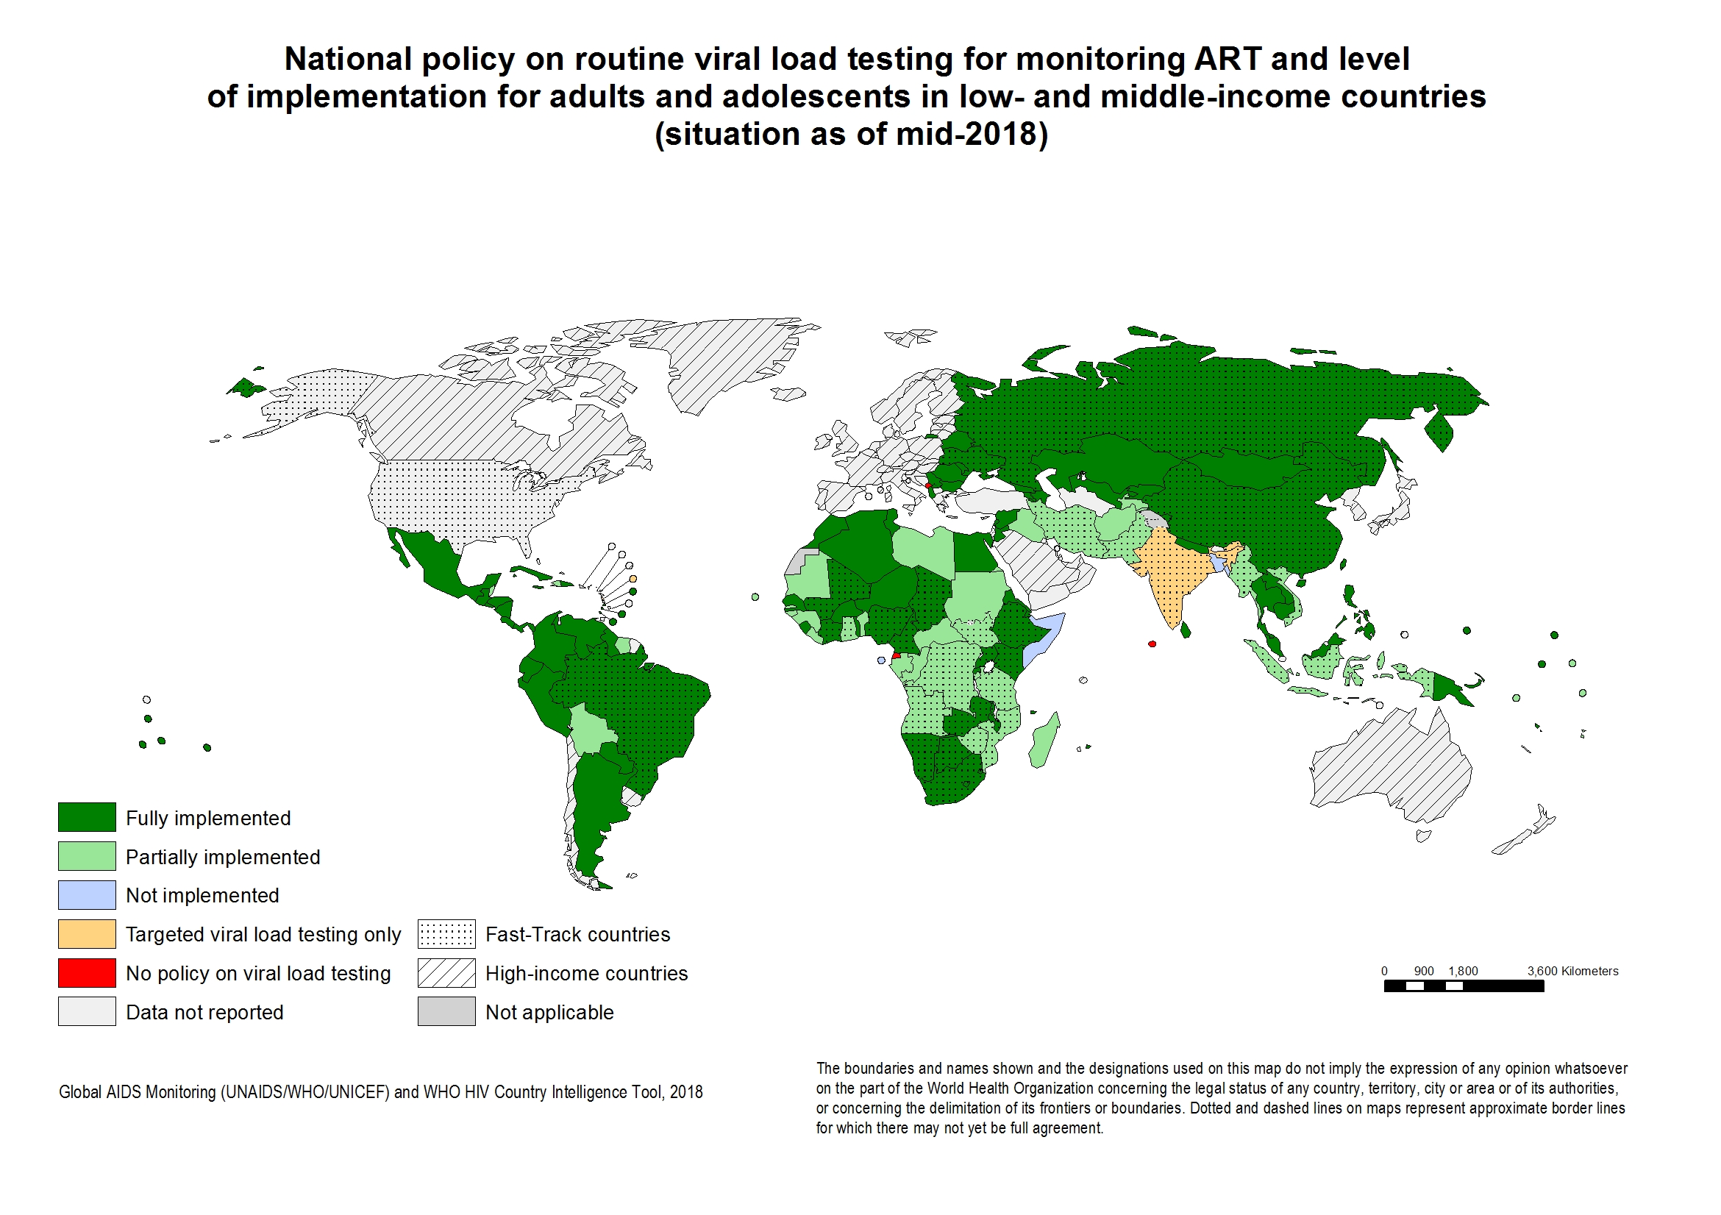
Momentum for VL scale-up

Slide 7
Rapid scale-up but gaps remain

Slide 8
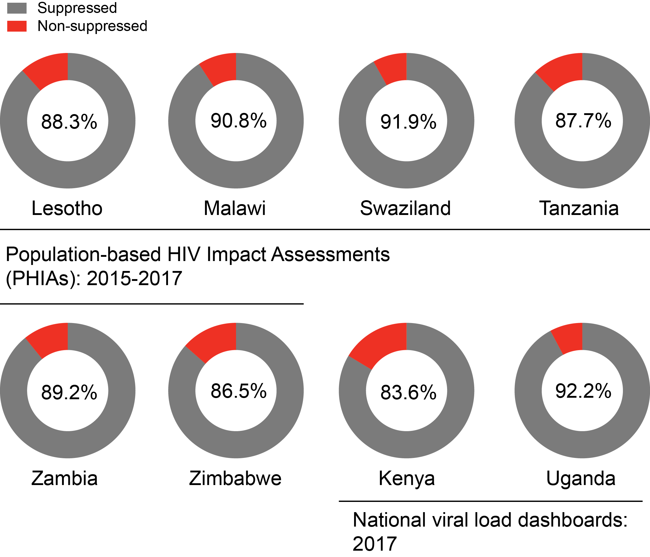
High viral suppression rates across countries

Slide 9
Clinical utility of viral load results
Across Kenya, Malawi, and Uganda, less than 10% of patients with an elevated first viral load proceed through the treatment failure algorithm and receive a second viral load test

Slide 10
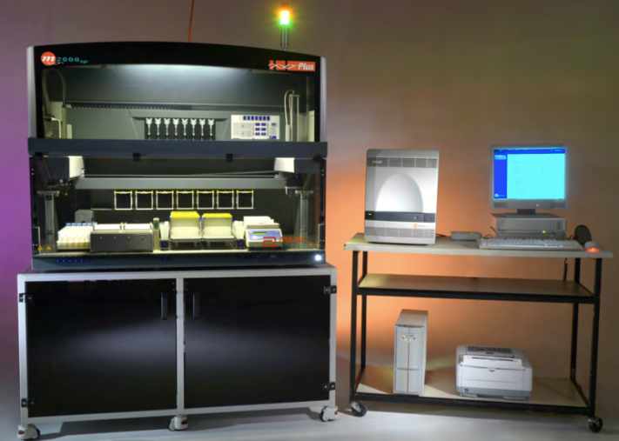
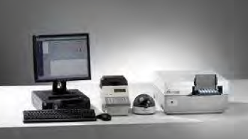
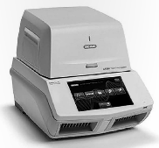
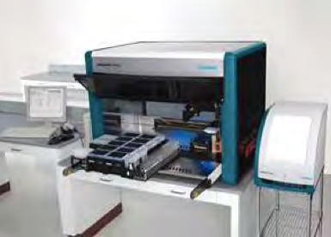

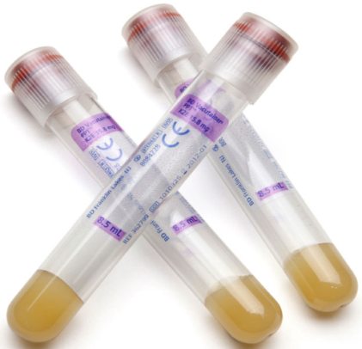
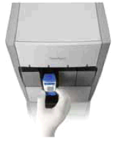
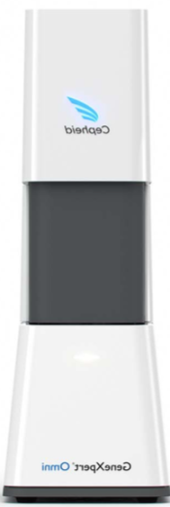

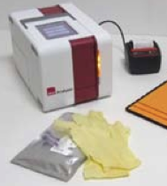
Increasing menu of options
WHO prequalification:
Abbott RealTime m2000
bioMerieux EasyQ
Cepheid Xpert
Hologic Aptima
Roche COBAS v2.0
Siemens VERSANT

Slide 11
Conclusions
Viral load scale-up is necessary and in progress in many countries yet significant access gaps remain
Elevated viral loads do not seem to be used consistently to support treatment failure and 2nd line switching.
Delayed or lack of switching could be due to several reasons:
  Poor clinical understanding of viral load; lack of trust
  Fragmented health and laboratory systems
  Drug supply

Slide 12
2016 WHO ARV Guidelines
Routine viral load testing
6 months
12 months
Yearly
ART initiation

Slide 13
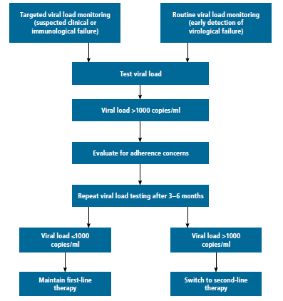
2016 WHO ARV Guidelines

